Slide 1
Creating
Inclusive Communities:
Pathways to the Vision

Slide 2
Inclusion entails recognition of our universal “oneness” and interdependence. Inclusion is recognizing that we are “one” even though we are not the “same.”
Shafik Asante

Slide 3
Place
Participation
Choice
Relationships

Slide 4
Community-based
Public Policy
Practice
Least Restrictive
Mainstreaming
Legislation
Litigation
Transformation

Slide 5
Equality
Accommodation

Slide 6
Relationships
Friendships
Home Ownership
Real Jobs
Spiritual Fulfillment
Personal Choice

Slide 7
All people are unique
Everyone can learn and grow
Everyone has gifts
Everyone desires to make contributions

Slide 8
Vision

Slide 9
Open and accessible for all
Each member takes active part
Safe and empowered
Voices are heard
Contributions acknowledged and valued
Rights and responsibilities
Unique strengths, resources, abilities and capabilities

Slide 10
Agencies
Typical community activities

Slide 11
Self contained service programs leaves people wandering in a blind alley

Slide 12
Inclusive communities directs attention to the network of streets and roads that can lead to opportunities for better lives for everyone.

Slide 13
Work
Live
Play
Grow

Slide 14
Strength, beauty, courage and
inherent gifts
People belong
Part of a family
Adults who nurture them
Regular schools
Classrooms with children
without disabilities
Regular school activities
Community recreation activities
Spiritual activities
Choose where one lives,
works, leisure and worship
Attending regular schools

Slide 15
Pathways

Slide 16
Shift in focus of planning from
deficiencies and needs
to capacities

Slide 17
People who know and love the person best should be involved

Slide 18
The role of Direct Support Professionals needs to move
from skills developer
to community connector

Slide 19
Organizations need to recognize that they serve a role in connecting people and their communities.

Slide 20
Conduct research on ways to support people to become contributing members of their communities.

Slide 21
Develop more affordable and accessible housing options in the community.

Slide 22
People should have opportunities to
  Earn a living wage
  Acquire benefits
  Advance their careers
  Plan for retirement

Slide 23
IDEA should be fully implemented

Slide 24
Reallocate federal resources from segregated “habilitation” to individualized supports

Slide 25
We must promote the values of acceptance and hospitality for all people.
If we don’t, how can we
expect it of others?

Slide 26
AAIDD should be at the forefront in promoting promising practices in the crafting of inclusive communities.

Slide 27
Acceptance of all people
Full citizenship
Deeper relationships
Cooperation and collaboration
Diverse community options

Slide 28
A Better World

Slide 29

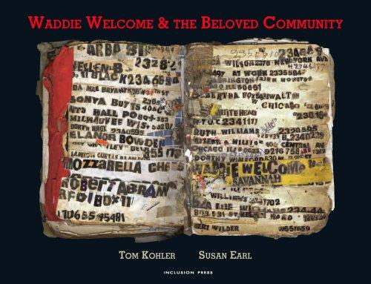

Slide 30


Slide 31
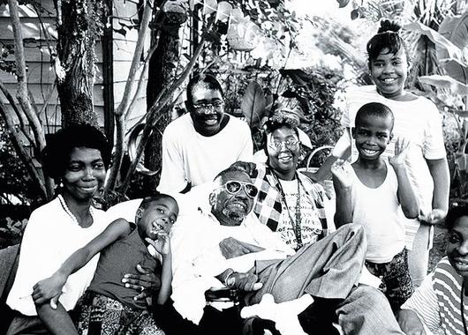

Slide 32
The beloved community is not a utopia, but a place where the barriers between people gradually come down and where the citizens make a constant effort to address even the most difficult problems of ordinary people. Rev. Jim Lawson

